Slide 1

IS 253 OBJECT ORIENTED PROGRAMMING

Slide 2
OVERVIEW
Course Expected Learning Outcomes
At the end of this course students are expected to be able to:
Use event driven programming skills.
Apply Object oriented Programming languages and scripting languages techniques.
Understand the features of object oriented programming
Use the tools and techniques of an object oriented language.
Design object oriented applications.
Implement object oriented applications

Slide 3
COURSE CONTENT
An overview of procedural and Object Oriented Programming Approaches: Understanding the difference between Object Oriented Programming and Procedural Programming Approaches. Features of Object Oriented Programming Languages i.e. Encapsulation, Inheritance, Polymorphism., Objects and Classes.
Object Oriented Design Essentials
Introduction of JAVA/C++ programming concepts: Introduction to programming concepts (variables, iteration, decision making)
Implementation of Basic Object Oriented Programming Concepts: Class Implementation and Creating Instances of Classes, Attributes, Methods, Members and Members Methods, Constructors.
Methods: Constructors, Methods/Constructor Overloading, Access Control Modifiers, Information Hiding and Encapsulation, The public Getters and Setters for private Variables, important keywords when dealing with methods, Dot Operator, constants.
Advanced Object Oriented Concepts: Polymorphism, Inheritance, Static and Dynamic Binding, Abstract Classes and Methods, Interfaces, Inner Classes, Mutable and Immutable Objects.
JAVA GUI Programming: Using swig to build GUI Based Applications, JAVA programs design patterns and security considerations and other emerging technologies.

Slide 4
OVERVIEW
Assessment: Coursework, 30%, Final Examination 70%.
Core Textbook
Introduction to Object-Oriented Programming, 3rd Edition, Addison Wesley
Reference Books
An Introduction to Object-Oriented Programming with Java 5th Edition
The Object-Oriented Thought Process, 3rd Edition, Addison Wesley Professional.

Slide 5
OBJECTIVES
Introduction to Object Oriented Programming Concepts

Slide 6
INTRODUCTION
What is Object-Orientation ?
A technique for system modeling.
An Object Oriented model consists of several interacting objects.
What is a Model ?
A model is an abstract representation of reality. Examples of Models include Highway maps, Architectural models, Mechanical models.
Notes:
Examples of Models include:

Slide 7




Examples of Object Oriented Models

Slide 8
Examples of Object Oriented Models
Ali
Lives
Inside
Teacher
House
Drives
Objects: Teacher, House, Car
Interactions: Teacher lives inside a house, Teacher Drives a car
Car

Slide 9
Object-Orientation - Advantages
People think in terms of objects, Object Oriented Models map to reality, therefore, OO models are:
easy to develop
easy to understand

Slide 10
Procedural VS Object Oriented Programming
Traditional Procedural Programming.
In traditional, procedural programming, data and functions are kept separate from the data they process.
This has a significant effect on the way a program handles data:
The programmer must ensure that data are initialized with suitable values before use and that suitable data are passed to a function when it is called.
If the data representation is changed, e.g. if a record is extended, the corresponding functions must also be modified.
Both of these points can lead to errors and neither support low program maintenance requirements.

Slide 11
Procedural VS Object Oriented Programming
Traditional Procedural Programming.
The procedural-oriented programs are made up of functions. Functions are less reusable. It is very difficult to copy a function from one program and reuse in another program because the function is likely to reference the global variables and other functions.
In other words, functions are not well-encapsulated as a self-contained reusable unit.

Slide 12
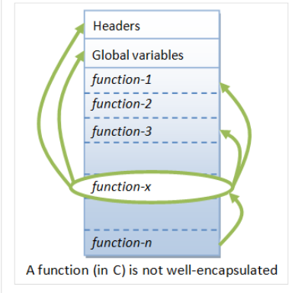
Procedural VS Object Oriented Programming

Slide 13
OBJECT ORIENTED PROGRAMMING (OOP)
Object-oriented programming shifts the focus of attention to the objects, that is, to the aspects on which the problem is centered.
A program designed to maintain bank accounts would work with data such as balances, credit limits, transfers, interest calculations, and so on.
An object representing an account in a program will have properties and methods that are important for account management.
OOP objects combine data (attributes) and functions (behaviors).
A class defines a certain object type by defining both the properties and the methods of the objects of that type.

Slide 14
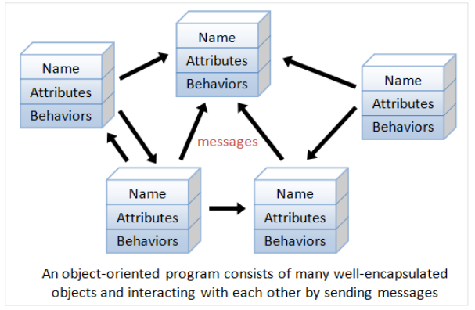
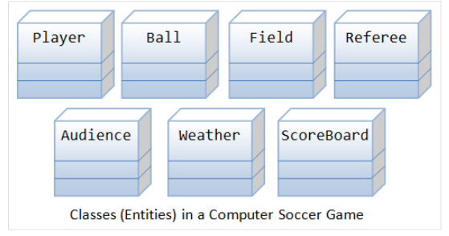
OBJECT ORIENTED PROGRAMMING (OOP)

Slide 15
OBJECT ORIENTED PROGRAMMING (OOP)
Object-oriented programming (OOP) refers to a type of computer programming in which programmers define not only the data type of a data structure, but also the types of operations (methods) that can be applied to the data structure.
In this way, the data structure becomes an object that includes both data and functions.
A programming language is object oriented if it directly supports:
Abstraction- providing some form of classes and objects.
Inheritance-providing the ability to build new abstractions out of existing ones.
Polymorphism-ability to process objects differently depending on their data type or class.

Slide 16
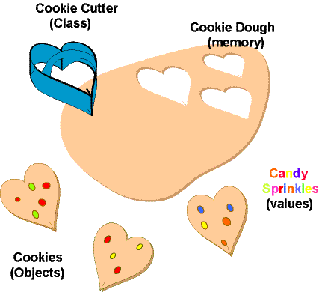
OBJECTS AND CLASSES
Class is a blueprint or template from which objects are created.
Object is an instance of a class.

Slide 17
OBJECTS AND CLASSES
It should be noted that, when designing Object Oriented Models a class should have:
State (attributes).
Well-defined behaviour (operations).
Unique identity.

Slide 18
OBJECTS AND CLASSES
From previous examples of object models:
Teacher has
State (attributes): Name, Age
behaviour (operations):Walks, Eats, Speaks
Identity: His name

Slide 19
OBJECTS AND CLASSES
From previous examples of object models:
Car has
State (attributes): Color, Model
behaviour (operations):Accelerate, Start Car, Stop Car
Identity: Registration Number

Slide 20
Information Hiding
Information is stored within the object
It is hidden from the outside world
It can only be manipulated by the object itself

Slide 21
Example – Information Hiding
Teacher's name is stored within his brain, We can’t access his name directly, Rather we can ask him to tell his name.

Slide 22
Example – Information Hiding
A phone stores several phone numbers
We can’t read the numbers directly from the SIM card
Rather phone-set reads this information for us

Slide 23
Information Hiding Advantages
Simplifies the model by hiding implementation details
It is a barrier against change propagation

Slide 24
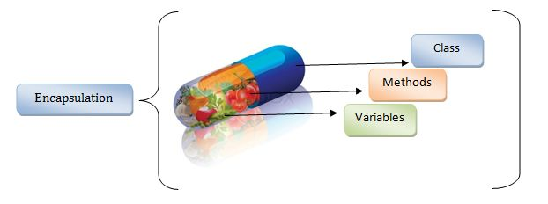
ENCAPSULATION
Encapsulation is the ability to package codes and data together in a place and hide (or prevent) that data from external contact thereby forcing anyone who wants to access it to pass through the associated code.
Structured programming encourages code everywhere to deal directly with data structures.

Slide 25
Example – Encapsulation
A Phone stores phone numbers in digital format and knows how to convert it into human-readable characters
We don’t know
How the data is stored
How it is converted to human-readable characters

Slide 26
Example – Encapsulation
Teacher stores his personal information and knows how to translate it to the desired language
We don’t know
How the data is stored
How the teacher translates this information

Slide 27
Encapsulation – Advantages
i. Simplicity and clarity
ii. Low complexity
iii. Better understanding

Slide 28
INHERITANCE
This is the ability of an existing class to create new classes.
Thus existing class is referred to as a base class and the newly created classes are called derived class.
The derived class inherits all the features inherent in the base class.
Inheritance is perhaps one of the most powerful features of object-oriented programming paradigm.
Inheritance can support program (or software) reuse, reliability, and modification of the base class

Slide 29
INHERITANCE
This is the ability of an existing class to create new classes.
Thus existing class is referred to as a base class and the newly created classes are called derived class.
The derived class inherits all the features inherent in the base class.
Inheritance is perhaps one of the most powerful features of object-oriented programming paradigm.
Inheritance can support program (or software) reuse, reliability, and modification of the base class

Slide 30
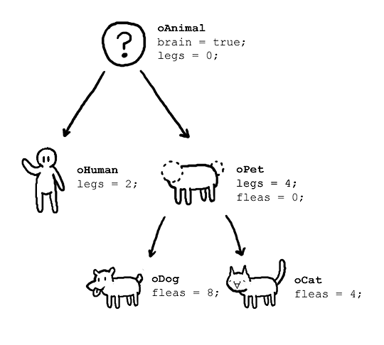
INHERITANCE

Slide 31
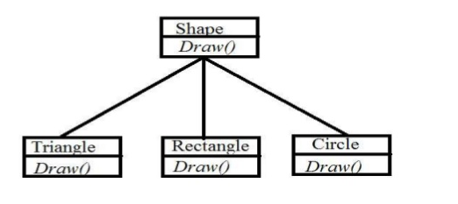
POLYMORPHISM
Polymorphism is a mechanism that allows objects of different types to respond differently to the same function call

Slide 32
ADVANTAGES OF OOP
Object-oriented programming offers several major advantages to software development:
■ reduced susceptibility to errors: an object controls access to its own data. More specifically, an object can reject erroneous access attempts
■ easy re-use: objects maintain themselves and can therefore be used as building blocks for other programs
■ low maintenance requirement: an object type can modify its own internal data representation without requiring changes to the application.

Slide 33
PRACTICAL SESSION
Objectives:
Getting started with JAVA (Installation).
Historical Background on JAVA
Running your first JAVA program.

Slide 34
INTRODUCTION TO JAVA
Java is a high level, robust, object-oriented and secure programming language.
Java is a programming language and a platform.
Java was originally developed by James Gosling at Sun Microsystems (which has since been acquired by Oracle Corporation) and released in 1995 as a core component of Sun Microsystems' Java platform.

Slide 35
INTRODUCTION TO JAVA
According to Sun, 3 billion devices run Java. There are many devices where Java is currently used. Some of them are as follows:
Desktop Applications such as acrobat reader, media player, antivirus, etc.
Web Applications such as irctc.co.in, javatpoint.com, etc.
Enterprise Applications such as banking applications.
Mobile
Embedded System
Smart Card
Robotics
Games, etc.

Slide 36
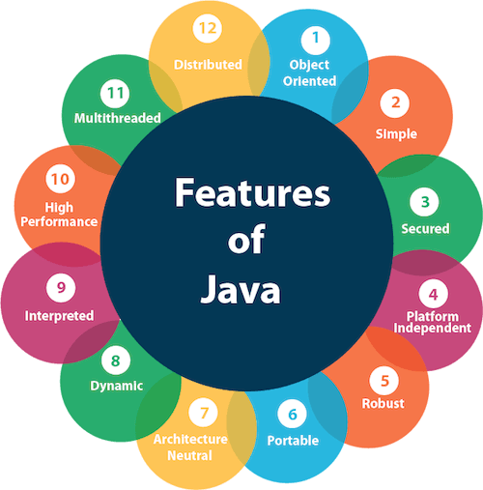
INTRODUCTION TO JAVA

Slide 37
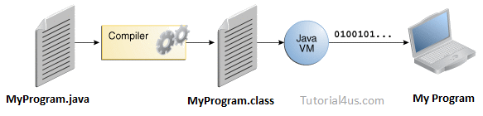
INTRODUCTION TO JAVA
Unlike conventional languages which are generally designed either to be compiled to native (machine) code, or to be interpreted from source code at runtime, Java is intended to be compiled to a bytecode, which is then run by a Java Virtual Machine. (JVM)

Slide 38
INTRODUCTION TO JAVA
Bytecode is program code that has been compiled from source code into low-level code designed for a software interpreter.
It may be executed by a virtual machine (such as a JVM) or further compiled into machine code, which is recognized by the processor.
The compilation of JAVA to bytecode allows this programming language to be platform independent.
A programming language or technology is said to be platform independent if and only if which can run on all available operating systems with respect to its development and compilation.

Slide 39
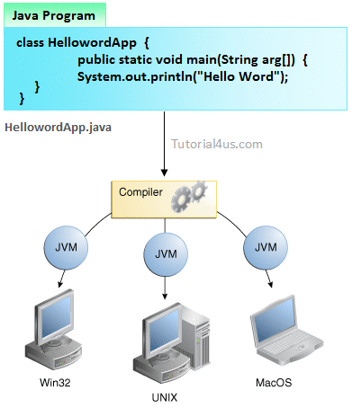
INTRODUCTION TO JAVA

Slide 40
ENVIRONMENT SETUP
In order to get started with developing Java applications, we need to install the Java Development Kit (JDK).
The Java Development Kit (JDK) is a software development environment used for developing Java applications and applets.
The JDK includes the Java Runtime Environment (JRE), an interpreter/loader (Java), a compiler (javac), an archiver (jar), a documentation generator (Javadoc) and other tools needed in Java development.
JRE stands for “Java Runtime Environment", it provides the minimum requirements for executing a Java application; it consists of the Java Virtual Machine (JVM), core classes, and supporting files.

Slide 41
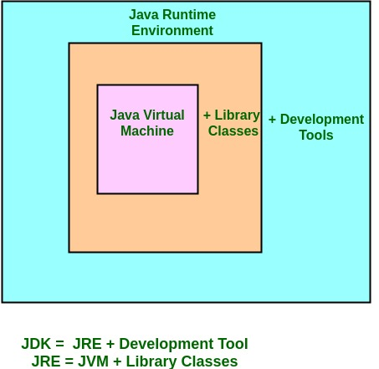
ENVIRONMENT SETUP
Notes:
JDK – Java Development Kit (in short JDK) is Kit which provides the environment to develop and execute(run) the Java program. JDK is a kit(or package) which includes two things
Development Tools(to provide an environment to develop your java programs)
JRE (to execute your java program).
Note : JDK is only used by Java Developers.
JRE – Java Runtime Environment (to say JRE) is an installation package which provides environment to only run(not develop) the java program(or application)onto your machine. JRE is only used by them who only wants to run the Java Programs i.e. end users of your system.
JVM – Java Virtual machine(JVM) is a very important part of both JDK and JRE because it is contained or inbuilt in both. Whatever Java program you run using JRE or JDK goes into JVM and JVM is responsible for executing the java program line by line hence it is also known as interpreter.

Slide 42



ENVIRONMENT SETUP
Install an IDE of your choice, there are several IDEs that support the development of Java programs.
In this course we shall use the IntelliJ Idea

Slide 43
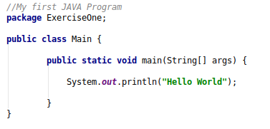
Writting your first program

Slide 44
Anatomy of a Java Program
Comments
Package
Reserved words
Modifiers
Statements
Blocks
Classes
Methods
The main method

Slide 45
Comments
In Java, comments are preceded by two slashes (//) in a line, or enclosed between /* and */ in one or multiple lines.
When the compiler sees //, it ignores all text after // in the same line.
When it sees /*, it scans for the next */ and ignores any text between /* and */.

Slide 46
Package
A java package is a group of similar types of classes, interfaces and sub-packages.
Java packages are used to categorize the classes and interfaces so that they can be easily maintained.
Java package removes naming collision.

Slide 47
Reserved Words
Reserved words or keywords are words that have a specific meaning to the compiler and cannot be used for other purposes in the program.
For example, when the compiler sees the word class, it understands that the word after class is the name for the class.
Other reserved words in Example 1.1 are public, static, and void. Their use will be introduced later in the course.

Slide 48
Modifiers
Java uses certain reserved words called modifiers that specify the properties of the data, methods, and classes and how they can be used.
Examples of modifiers are public and static. Other modifiers are private, final, abstract, and protected.
A public datum, method, or class can be accessed by other programs.
A private datum or method cannot be accessed by other programs.

Slide 49
Statements
A statement represents an action or a sequence of actions.
The statement System.out.println("Welcome to Java!") in the program in our example is a statement to display the greeting "Welcome to Java!"
Every statement in Java ends with a semicolon (;).

Slide 50
Blocks
A pair of braces in a program forms a block that groups components of a program.

Slide 51
Classes
The class is the essential Java construct.
A class is a template or blueprint for objects.
To program in Java, you must understand classes

Slide 52
Methods
What is System.out.println? It is a method: a collection of statements that performs a sequence of operations to display a message on the console.
It can be used even without fully understanding the details of how it works.
It is used by invoking a statement with a string argument.
The string argument is enclosed within parentheses.
In this case, the argument is "Hello Wordl!"
You can call the same println method with a different argument to print a different message.

Slide 53
main Method
The main method provides the control of program flow. The Java interpreter executes the application by invoking the main method.
The main method looks like this:
public static void main(String[] args) {
// Statements;
}

Slide 54
Displaying Text in a Message Dialog Box
You can use the showMessageDialog method in the JOptionPane class.
JOptionPane is one of the many predefined classes in the Java system, which can be reused rather than “reinventing the wheel.”

Slide 55
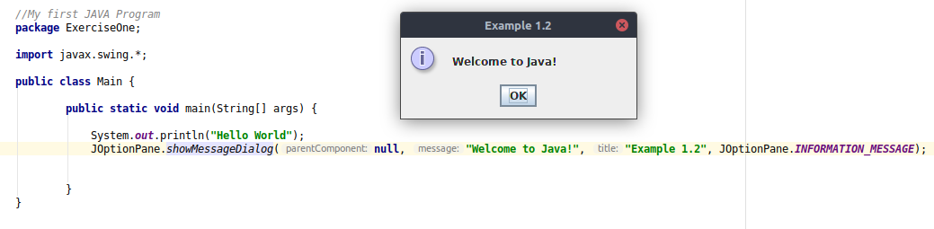
Displaying Text in a Message Dialog Box

